Slide 1

Notion’s Sustainable Growth Story Going Forth
Notion VTEC Berhad Dated: 26 Feb 2024
Disclaimer: This presentation is not financial advice. The company assumes no responsibility or liability for any errors or omissions in this presentation. The information is provided on an “as is” basis with no completeness, accuracy, usefulness or timeliness. Please consult your financial adviser for investment advice.

Slide 2

Financials QoQ RM’ mils
 | Q1 FY2024 | Q4 FY2023
Revenue | 94 | 100
PBT/LBT | 13 | -38
PAT/LAT | 8 | -36
EBITDA | 20 | -29

Slide 3
Segments Comparison QoQ RM’ mils
Segments | Q1 FY2024 | Q4 FY2023
HDD | 23 | 16
Automotive | 32 | 28
Camera | 6 | 3
EMS | 32 | 51
PPE | 0.3 | 1
Total | 94 | 100

Slide 4
Financials YoY RM’ mils
 | Q1 FY2024 | Q1 FY2023
Revenue | 94 | 83
PBT/LBT | 13 | -0.5
PAT/LBT | 8 | -4
EBITDA | 20 | 8

Slide 5
Segments Comparison YoY RM’ mils
Segments | Q1 FY2024 | Q1 FY2023
HDD | 23 | 23
Automotive | 32 | 26
Camera | 6 | 6
EMS | 32 | 26
PPE | 0.3 | 1.5
Total | 94 | 83

Slide 6

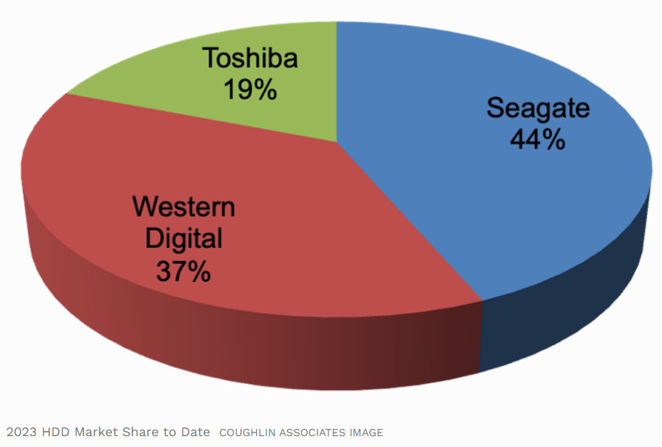
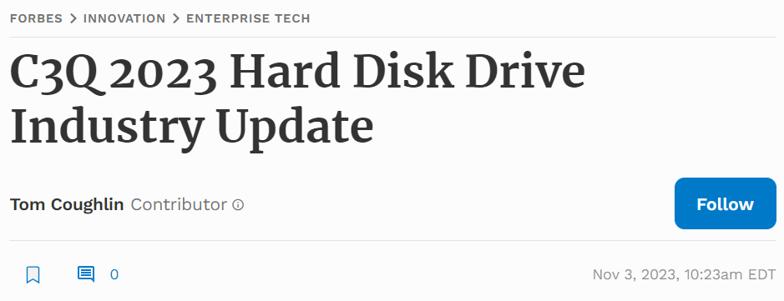
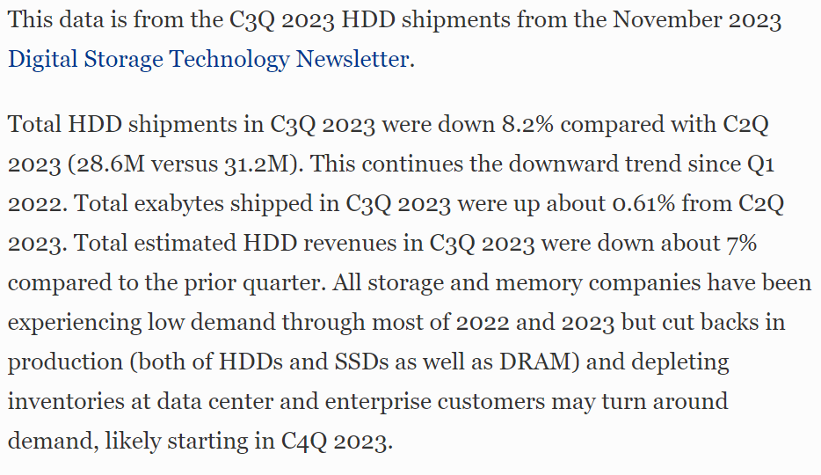
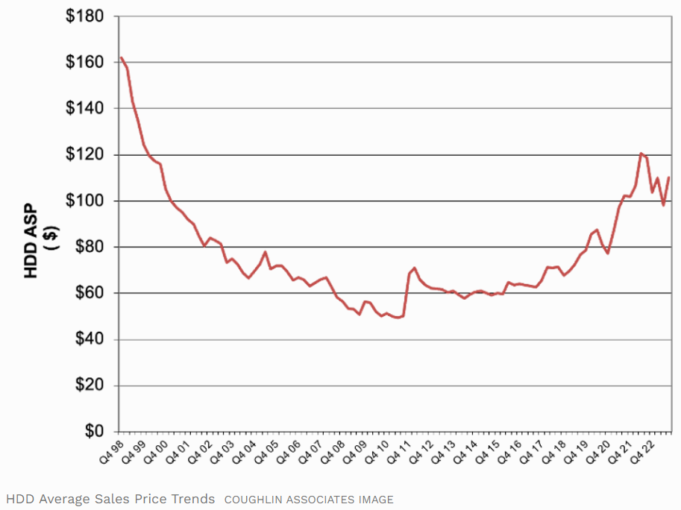
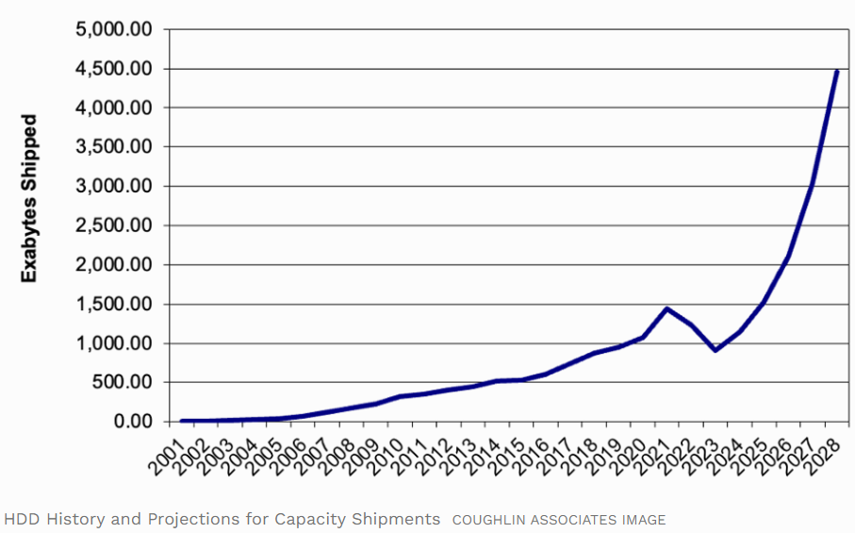
HDD Market Outlook
HDD Hard Disk Drive
Reference:https://www.forbes.com/sites/tomcoughlin/2023/11/03/c3q-2023-hard-disk-drive-industry-update/?sh=7d40e14c3bed

Slide 7
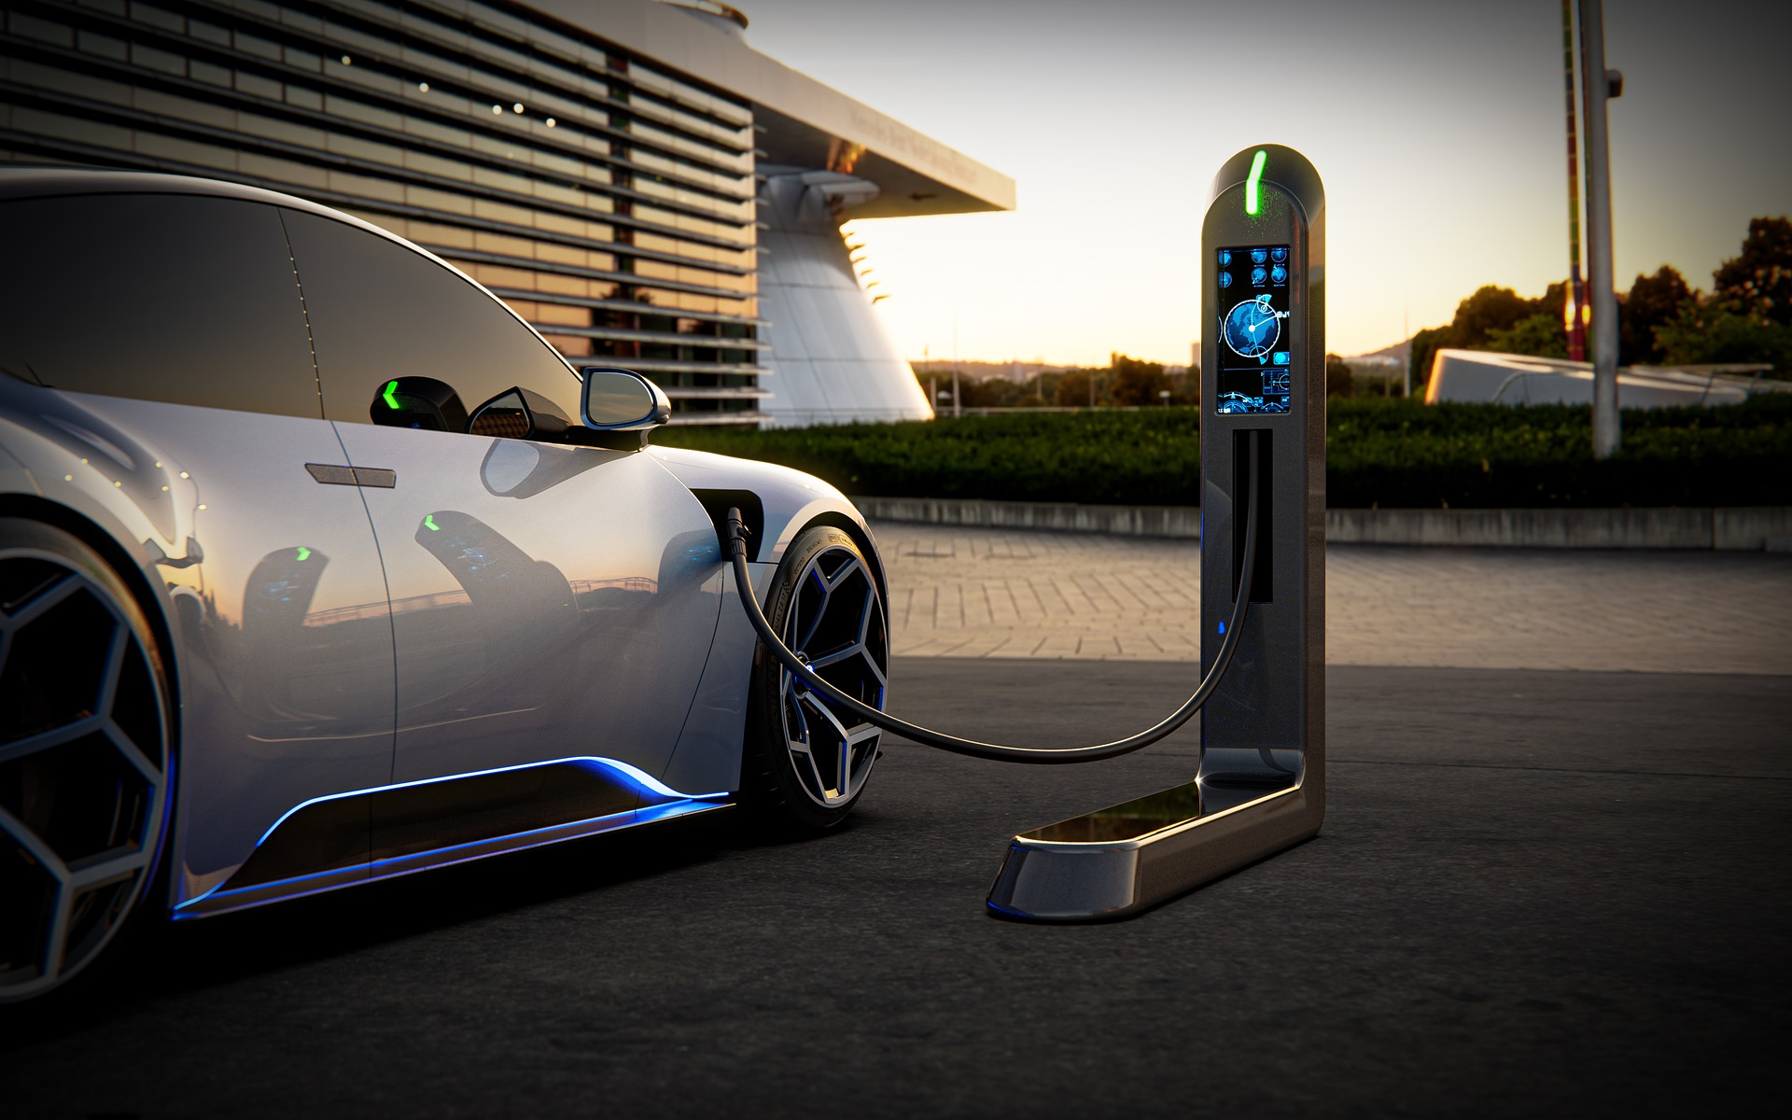
Automotive Vehicles Market:
EV adoption Increases Worldwide
Europe and China are the biggest market for EV
EV sales is about 4% of all vehicles sold
By 2023, there are more than 14 million EV on the road
Bloomberg expects EVs to account for 10% of all new car sales by 2025 and 58% by 2040
Net zero emission goals with set datelines in many European countries will see the demise of ICE cars
Tesla and BYD are the key players

Slide 8

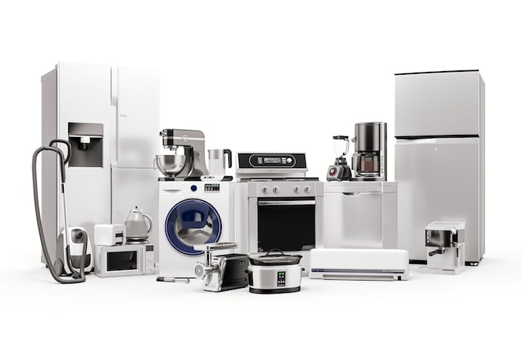

CONSUMER APPLIANCES MARKET OUTLOOK
Future Market Insights report, global consumer appliances market
USD 438 billion in 2023
The market size value forecast in 2033 is USD 680 billion.
Growth rate Global is 4.5%
(Forecast Period is 2023 to 2033)

Slide 9

CONSUMER APPLIANCES MARKET OUTLOOK
Key Factors shaping the Demand Outlook:
Increasing the application of small appliances eg. irons, toasters and hair dryers to augment growth
Increasing adoption of advanced kitchen appliances
Increasing purchasing power
Growing advances in technology to create new growth prospects

Slide 10




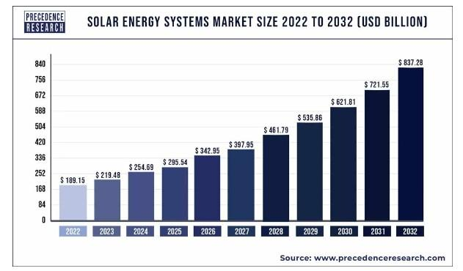
GLOBAL SOLAR ENERGY SYSTEMS MARKET OUTLOOK
CAGR 16%
2022
USD189 billion
2032
USD837 billion
Source: Precedence Research

Slide 11





CAPEX & Resources for growth projects
HDD spacer production expansion
New hubs in China, Mexico and Philippines in consumer appliances manufacture
Automotive components: relocation and expansion in Notion Thailand
Expansion in Johor plants to cater for 2 new customers DIY cutters and semi-cond sector
Finalizing a JV project in the solar panel frame manufacture in Klang Plant 3. Expected to come onstream in mid 2025 and impact FY2026
New zinc casting and zinc surface treatment facility in Klang for consumer appliances motor housing project

Slide 12

Conclusions
We cannot wait for a recovery of the PPE industry and decided to fully impair the investments in the last quarter. Needless it was a painful decision
Main growth is in HDD, Automotive and Consumer Appliances in foreseeable future
The past 5 years the annual revenue is between RM300 to 350 million. Impacted by both the fire in 2017 as well as Covid period
New overseas locations to match customers need
The Group needs a catch up major project in new JV on solar panel frame to bring the Group annual revenue closer to target RM1 billion when fully running in mid 2025

Slide 13
Thank You

