Slide 1

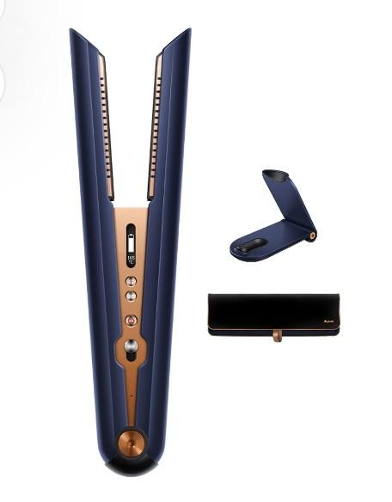
Q2 FY2024
Notion VTec Bhd-
March Quarter
The Surging Story
Date: 20 May 2024
Disclaimer: none of this is financial advice and the company is not responsible for any error or misinformation. Please seek your financial advisor in your investment decisions.

Slide 2
Your best quote that reflects your approach… “We try our best to deliver more than what we have promised.”
- Notion group

Slide 3

Quarter on Quarter segmental comparison
SEGMENT Q2FY24 Q1FY24 Q4FY23 Q3FY23 Q2FY23
RM ‘ mil
HDD 29.5 23.0 16.4 15.9 26.0
(26.4%) (24.5%)
AUTO 33.2 31.8 28.1 26.6 28.5
(30%) (34%)
EMS 36.1 32.0 51.1 35.2 24.3
(32.3) (34%)
CAMERA 12.6 6.7 4.1 5.4 5.7
/Industrial (11.3) (7%)
Total 111.5 93.7 99.8 83.1 84.6
All segments UP in Q2FY24
EMS customer already major since FY23

Slide 4

Quarter on Quarter Financial comparison
FINANCIAL Q2FY24 Q1FY24 Q4FY23 Q3FY23 Q2FY23
RM ‘ mil
Revenue 111.5 93.7 99.8 83.1 84.6
Gross P 23.8 21.7 8.4 6.5 2.0
% (21.3%) (23%)
PBT 17.7 13.0 -37.9 2.7 -6.7
(15.9%) (13.9%)
PAT 14.0 8.0 -35.9 1.8 -7.7
% (12.6%) (8.5%)
EBITDA 23.4 19.9 -29.0 11.2 1.5
% (21%) (21.2%)
Cash 50.4 52.2 49.0 39.4 25.4
Borrowings 31.8 32.7 33.2 38.6 43.7
B.E.P. for Group sales of RM84 mil/qtr
Net cash since Q3FY23
Q4FY23 healthcare impairment & inventory W/O: RM39 mil

Slide 5
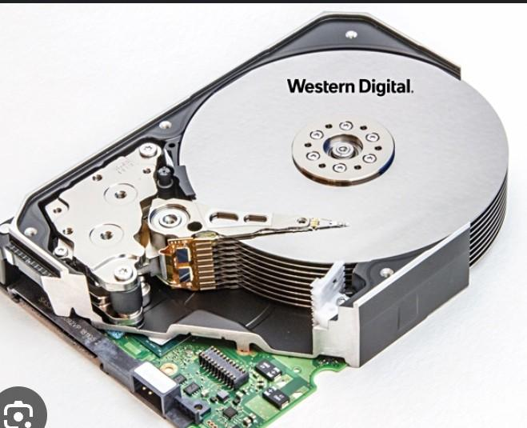
HDD Shifting Demand Outlook
1. Reported shortage of HDD and SSD in market due to prolong squeeze on inventory for past year causing fresh demand in orders.
2. Global trend in imaging AI application in autonomous taxi and humanoid AI robotics has resulted in new demand for AI machine learning data storage and the growth is exponential.
3. It is expected Robotaxi and humanoid AI robots have potential disruption to transportation and the global labour market meaning the total addressable market is the human population of 8 billion units.
4. The migration from aluminium HDD media platter to glass will bring new opportunities for growth as the large capacity HDD grows to 50 TB per HDD capacity in the foreseeable future.
5. We expect steady growth in large capacity HDDs and vendors in the space will benefit.

Slide 6
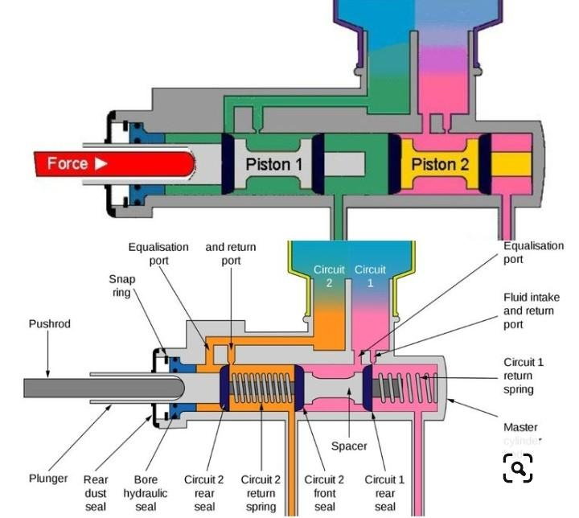
1. Notion is not a car maker but rather we produce a car aluminium braking component , plunger about 16 million units of plunger a year an supply to a European based auto-parts group.
2. Customer supplies these plungers to major car makers both ICE/EV.
3. We expect to increase our plunger capacity by 30 to 40% from current in order to reduce supply from other supplier. This increase will impact FY2025 onwards once finalized.
4. The automotive industry faces the sanctions effect of the greater trade war and it brings fresh opportunities.
Automotive Opportunistic OUTLOOK

Slide 7
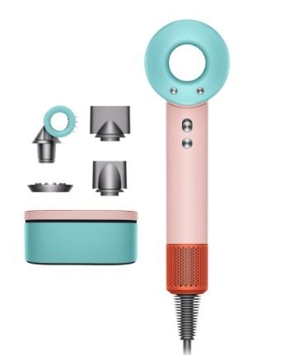
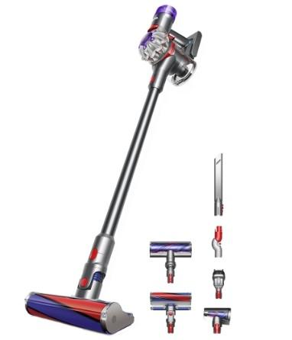
EMS Bright Outlook
1. Our EMS segment has grown into a major contributor to the Group’s business.
2. For the foreseeable future, we will have strong steady growth in this high end appliances business where we supply high quality finishing metal parts for our end customers.
3. We continue to engage with our customers in R&D efforts and provide complete services to help them get the optimal metal components within economical prices.
4. We continue to invest in long term relationships for a sustainable future and always matching customers’ expectations.
5. We foresee excellent growth opportunities near and long term.

Slide 8
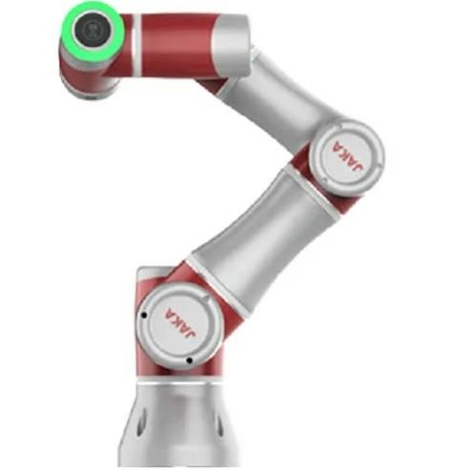
1. Notion is a Technology based group and we have inhouse capability for pick and place automation in combination with the CNC machining process.
2. We have a program to reduce manual labour by developing PLC controlled optical Inspection and collaborative Robots.
3. Cobots will be installed for labour intensive processes as price of Cobots have become affordable.
4. With rising cost of labour and uncertainty of foreign labour, it is the Group’s aim to reduce labour with automation, robotics and AOI.
AutomatiC OPTICAL inspection (AOI) and robotics capabilities

Slide 9
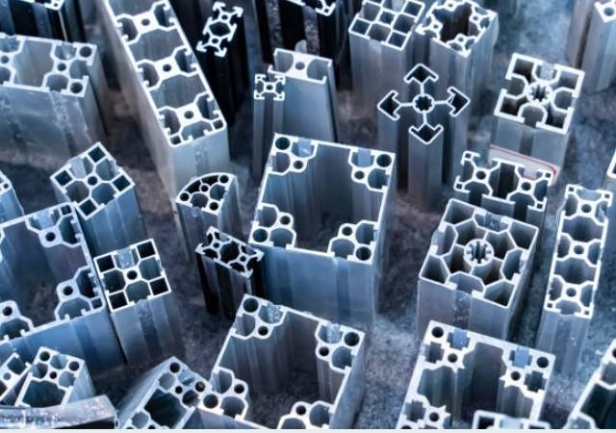
Scalable Core Business to exceed RM1 billion annual revenue by 2026: High Tonnage Aluminium Extrusion
1. Notion has 3 Core business segments HDD, Auto & EMS but in order to cross into the RM1 billion sales a year, we need a 4th Core business.
2. We have identified high tonnage value-added aluminium extrusion project to JV with a reputable and financially strong China group for the exports market.
3. The benefit of the extrusion business is it is relatively lesser capex for high tonnage raw material business with expertise from an established player. The risk of unable to market is avoided.
4. We intend to locate this business in the Klang factory 3 for ease of control and monitoring.

Slide 10

The Trade War Opportunities
1. Notion is positioned to benefit from the continuing trade war resulting in both Chinese companies facing insurmountable high tariffs as well as Western MNCs needing to source from non Chinese supply chain.
2. We will continue to search for the best deals for the benefit of the shareholders.
3. Within the next 3 months, we should have clinched a JV deal with a China partner in the high volume aluminium extrusion exports business.
4. Within the next 3 months, we expect to have agreed with our current customer in the automotive plunger business to increase our capacity significantly for FY2025.

Slide 11

SUMMARY:
1. EMS sector is surging in orders and already the main contributor.
2. Notion is firing on all 3 cylinders HDD, Auto & EMS into foreseeable future.
3. High tonnage aluminium extrusion business will break RM1 billion revenue target by 2026.
4. The Trade War brings continuing opportunities.
5. Notion continues to increase productivity and lower costs by automation, AOI and Cobots.
6. Smooth execution of new projects is main risk.

Slide 12

Thank You

